Slide 1
ME 141
Engineering Mechanics
Portion 10
Kinetics: Work and Energy Approach
Partha Kumar Das
Assistant Professor
Department of Mechanical Engineering, BUET
http://parthakdas.buet.ac.bd

Slide 2
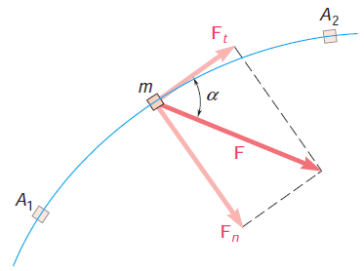
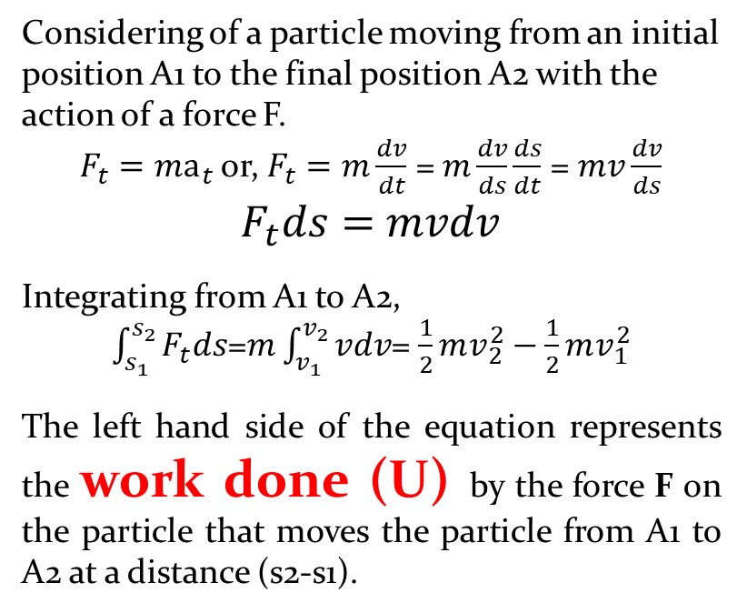
Principle of Work and Energy
Considering of a particle moving from an initial position A1 to the final position A2 with the action of a force F.
$F_{t}=ma_{t}$ or, $F_{t}=m\frac{dv}{dt}$ = $m\frac{dv}{ds}\frac{ds}{dt}$ = $mv\frac{dv}{ds}$
$F_{t}ds=$ $mvdv$
Integrating from A1 to A2,
$\int_{s_{1}}^{s_{2}}{F_{t}ds}$=$m\int_{v_{1}}^{v_{2}}{vdv}$= $\frac{1}{2}mv_{2}^{2}−\frac{1}{2}mv_{1}^{2}$
The left hand side of the equation represents the work done (U) by the force F on the particle that moves the particle from A1 to A2 at a distance (s2-s1).
On the other hand, the right hand side of the equation is the difference between kinetic energies (T) of the particle at two points A2 and A1, respectively.
$$U_{1−2}=T_{2}−T_{1}$$
This is the representative equation of principle of work and energy: The Work done on a particle causes a change in the kinetic energy of the particle and the value of the work done is essentially equal to the change in kinetic energy.

Slide 3
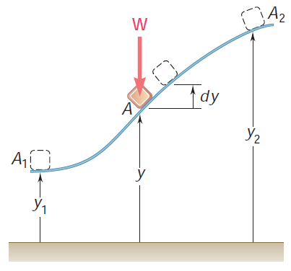
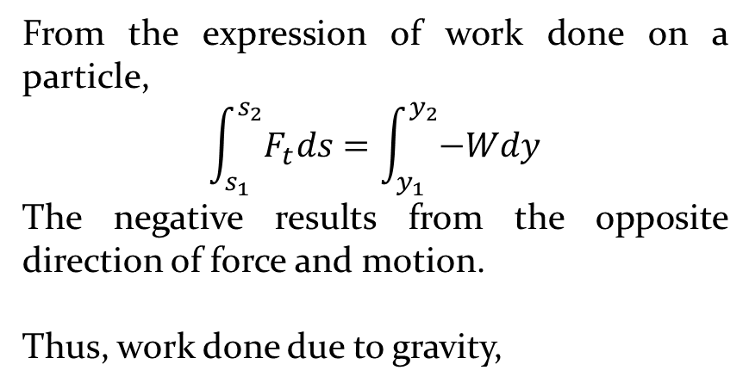
Work Done due to Gravity
From the expression of work done on a particle,
$$\int_{s_{1}}^{s_{2}}{F_{t}ds}=\int_{y_{1}}^{y_{2}}{−Wdy}$$
The negative results from the opposite direction of force and motion.
Thus, work done due to gravity,
$U_{1−2}$ = -W($y_{2}$-$y_{1}$)= W($y_{1}$-$y_{2}$)
$U_{1−2}$ =mg($y_{1}$-$y_{2}$)= mg$y_{1}$- mg$y_{2}$
$U_{1−2}$ = P1-P2
P1 and P2 are the potential energies at initial point and final point, respectively.

Slide 4
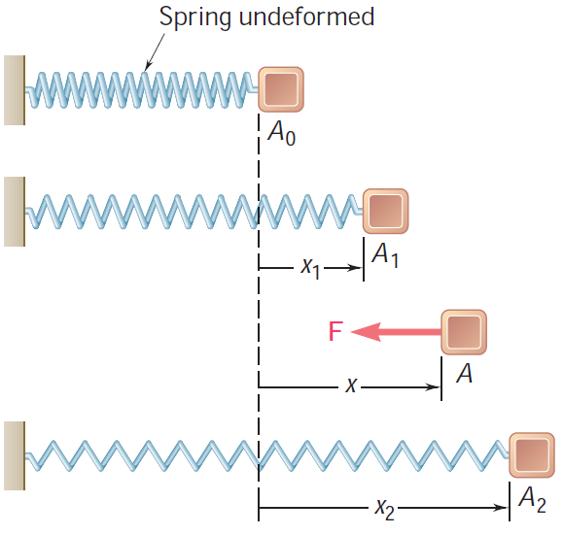
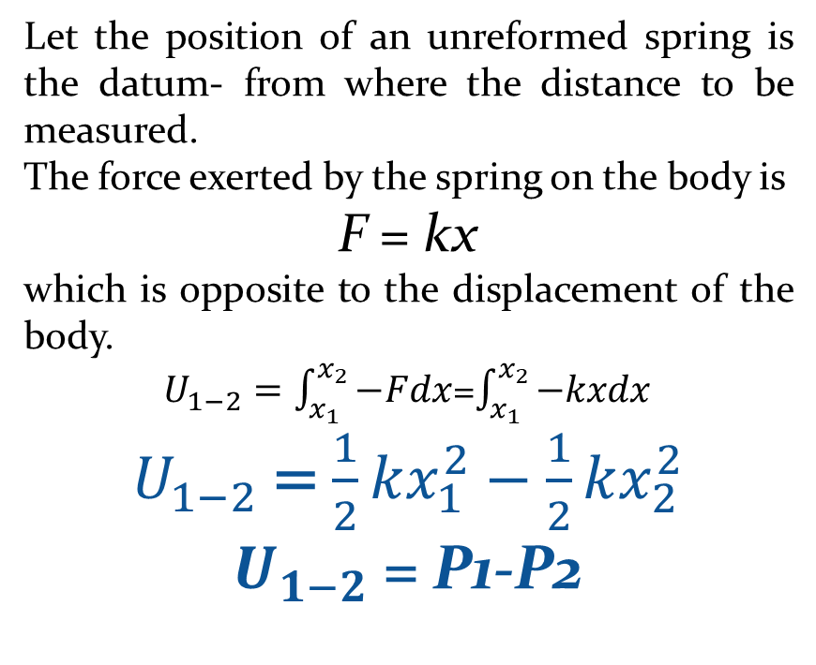
Work Done by A Spring
Let the position of an unreformed spring is the datum- from where the distance to be measured.
The force exerted by the spring on the body is
F = kx
which is opposite to the displacement of the body.
$U_{1−2}=\int_{x_{1}}^{x_{2}}{−Fdx}$=$\int_{x_{1}}^{x_{2}}{−kxdx}$
$U_{1−2}$ = $\frac{1}{2}kx_{1}^{2}−\frac{1}{2}kx_{2}^{2}$
$U_{1−2}$ = P1-P2
P1 and P2 are the potential energies at initial point and final point, respectively.

Slide 5
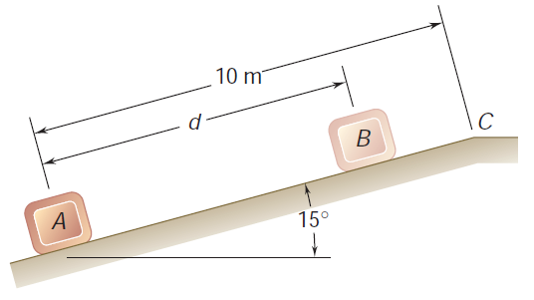
Problem 10.1 (Beer Johnston_10th edition_P13.9)
A package is projected up a 15° incline at A with an initial velocity of 8 m/s. Knowing that the coefficient of kinetic friction between the package and the incline is 0.12, determine
(a) the maximum distance d that the package will move up the incline,
(b) the velocity of the package as it returns to its original position.

Slide 6
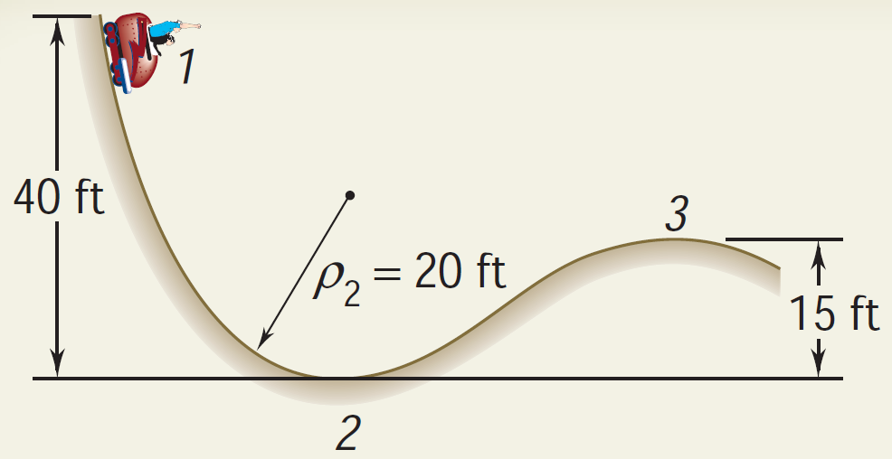
Problem 10.2 (Beer Johnston_10th edition_Ex13.4)
A 2000-lb car starts from rest at point 1 and moves without friction down the track shown.
Determine the force exerted by the track on the car at point 2, where the radius of curvature of the track is 20 ft.
Determine the minimum safe value of the radius of curvature at point 3.

Slide 7
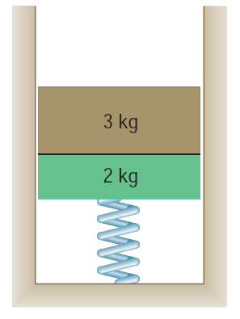
Problem 10.3 (Beer Johnston_10th edition_P13.26 and 13.27)
A 3-kg block rests on top of a 2-kg block supported by a spring of constant 40 N/m. The upper block is suddenly removed. Determine
the maximum speed reached by the 2-kg block,
the maximum height reached by the 2-kg block.
CASE 1: 2 kg block is not attached to the spring,
CASE 1: 2 kg block is attached to the spring.

Slide 8
END OF PORTION 10

Slide 9
References
Vector Mechanics for Engineers: Statics and Dynamics
Ferdinand Beer, Jr., E. Russell Johnston, David Mazurek, Phillip Cornwell.

